Slide 1


Cursillo
Empowering the mission of the church

Slide 2
What is Cursillo?
A ministry of The Episcopal Church
  Functions under authority of its Bishops
  Community based and structured
  Involves clergy and laity
Originated in Spain in the Roman Catholic Church (hence the Spanish terms)
  Now ecumenical and international
  5 million+ attendees worldwide
A weekend and a lifetime!

Slide 3

The Mission of Cursillo
Empowering the mission of the church

Slide 4
Goals of Cursillo
To give a personal experience of the Good News of God’s love in Jesus Christ
To deepen identity as part of the Body of Christ, the Community of the Beloved
To empower us to live and share that Good News
To encourage prayer, study, action & connection
To increase participation in congregational life

Slide 5
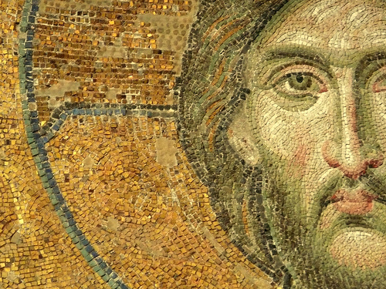
Cursillo Components
Three-Day Weekend
The Fourth Day

Slide 6
Three-Day Weekend
  Series of talks and meditations, given by laity and clergy
  Small group discussion – talking about what it means to me, to us, for us
  Sharing, bonding, laughing, singing, eating
  Experiencing the love of God and others

Slide 7
Some of this has to sound boring
– but it isn’t.
Because God shows up.

Slide 8
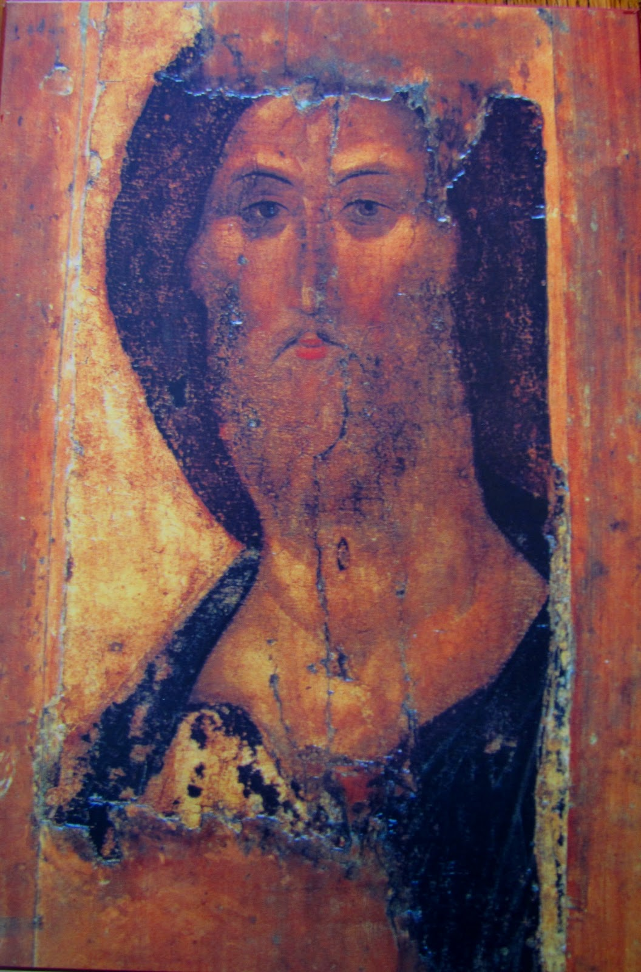
The Fourth Day
  The rest of one’s life
  Bringing the joy of Christ
  to our world
  Outreach
    In our own congregations
    In our communities

Slide 9

The Fourth Day
  Specific support for prayer,
  study, and action through:
    Ongoing small groups to
    encourage one another
    Larger gatherings
    to hear encouraging examples
    of Christian action (Ultreya).

Slide 10
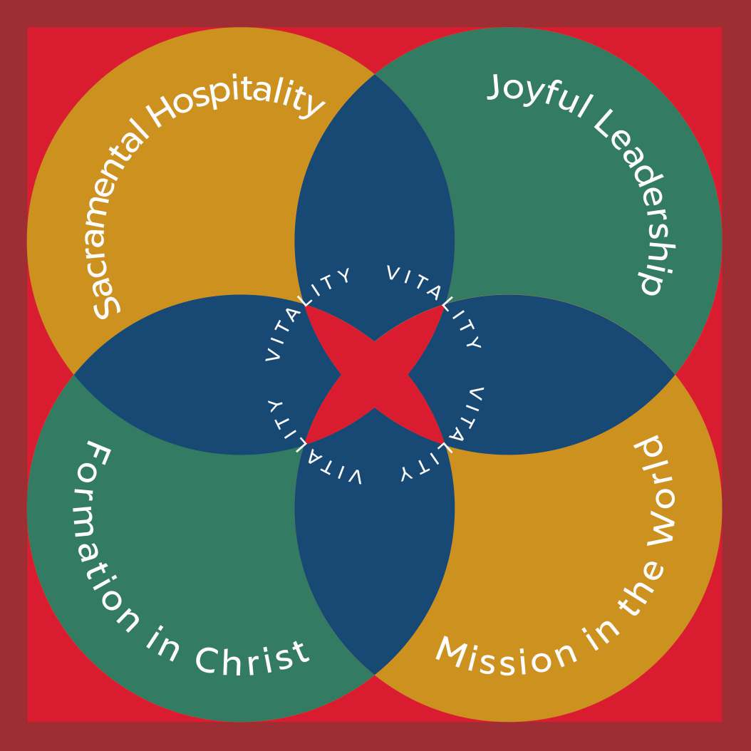
Cursillo lives the Marks of Congregational Vitality

Slide 11
What says the former Archbishop of Canterbury?
Through Cursillo the love of God is experienced afresh, an experience which draws us into prayer and compassionate action. Because of this, Cursillo is a much needed instrument for the renewal of the life of the Church today, and one for which I give thanks.
The Most Reverend Justin Welby

Slide 12
What says the former Presiding Bishop?
When I look to see where the spirit is moving and Episcopalians are lit up with the love of Christ and each other, I know to look to Cursillo. This ministry is such a gift to the Episcopal Church, and never more than in this moment as we seek to follow our Lord’s call into the Jesus Movement.
Presiding Bishop Michael Curry

Slide 13
What say another former Presiding Bishop?
I attended a Cursillo Weekend in 1991 as I began to answer a call to deeper engagement in God’s mission. It was a profound experience of God’s love in community, and I learned much. Cursillo is an ongoing opportunity to grow – in capacity for loving action in the world, in deepened engagement in community, in awareness of God’s action in our lives, and more conscious and open relationship with God. If you are seeking MORE in your life, come and see!
Former Presiding Bishop Katharine Jefferts Schori

Slide 14
What Does a Former Bishop of Oregon say?
I made my Cursillo in 1981 in Oklahoma along with my wife, Marla. It was a powerful experience with the love of God in community. I recommend it to anyone interested in deepening their faith and commitment to Jesus Christ. Yes, God can be encountered in many places and in many ways, but God is often most powerfully experienced in community. Cursillo provides a wonderful experienced and the presence of God in community.
        Bishop Michael Hanley

Slide 15
What does the Former Bishop of Olympia say?
To me, Cursillo is Christianity 101. When I made my Cursillo over 25 years ago I remember finding, in those grace-filled, and a bit challenging days, how much I did not know, how much I had yet not experienced about our faith. I found a depth there that has never faded. It also taught me more about Christian community, and Christian leadership. My faith, and therefore my life, was enriched in those days, and that has grown ever since.
Bishop Greg Rickel

Slide 16
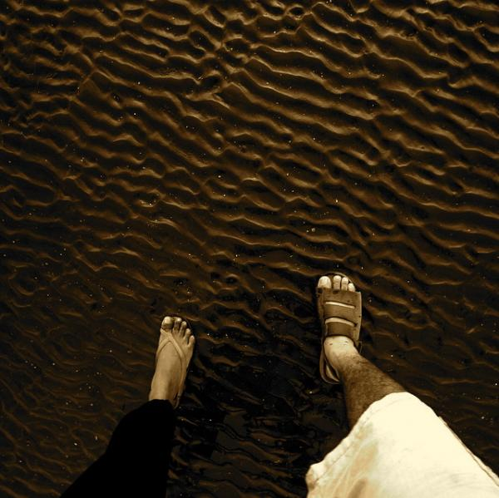
What Do Clergy Say?

Slide 17
Clergy say:
Cursillo helps people to claim their ministries and to become enthusiastic and charged up about their faith in God.
People have a higher level of commitment and church stewardship has much more meaning for them.
Having encountered God in a deeper way, folks often thirst for fresher ways to praise and worship God.
Notes:
Add verbally or in the hand out, attributed quotes from some of your local priests.

Slide 18
Clergy say:
Small groups provide encouragement for study, prayer, and clear support for discipleship, outreach projects, and evangelistic sharing of faith.
There is more energy for outreach into the community, when dynamic lay people share about how they have encountered God in caring for those who are struggling.
Notes:
Add verbally or in the hand out, attributed quotes from some of your local priests.

Slide 19
Clergy say:
Music ministry is more dynamic.
There is more prayer support and a shared biblical reflection with the priest.
Higher level of financial commitment.
Lay Leaders who take morning prayers and reflections are more focused in their faith sharing.
Enlivened lay people engage in active ministry.

Slide 20
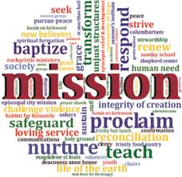
What do Parishioners Say?

Slide 21
Before I went to Cursillo, I was pretty sure that God loved me, but I really wasn’t too sure about the rest of you. Now I know that you do.

Slide 22
Through Cursillo, for the first time, I came to realize the truth and reality of the Body of Christ. My involvement in the Cursillo community has given me a place where I have grown, celebrated, been challenged and been refreshed in my walk with our Lord and His church.

Slide 23
I found the Cursillo weekend to be practical in that it was the beginning of the strengthening of my faith and my trust in Him to step out and make some much needed changes in my life.

Slide 24
I had more fun at Cursillo than I did on my honeymoon!

Slide 25
The Cursillo weekend re-awakened the love and compassion God has for me. This made me realize the need to love and serve in a genuine way in return, and not just go through the motions. I recommitted to God, to serve and to try to show that in my everyday life to others.

Slide 26
The most important part came after the
weekend. Being part of a Group Reunion that meets regularly and has shared deeply over many years has strengthened my walk with Christ, and continues to challenge me.

Slide 27
Cursillo has a version for prisoners, called Kairos Inside, and a version for women affected by someone’s incarceration, called Kairos Outside. Through participating in each of these, I have seen God make miraculous transformations in people’s lives. Jesus and the Gospel change everything.

Slide 28
Summary
Cursillo is a ministry of The Episcopal Church
Strengthens parishioners to find their mission call
Develops a life of Christian discipleship and fellowship
Nurtures congregational leadership and ministry
Sends forth servant leaders

Slide 29
More information
www.Oregon-Cursillo.org (don’t forget the hyphen)
Facebook – Oregon Episcopal Cursillo
https://www.facebook.com/groups/94289009763
oregoncursillo@gmail.com

Slide 30


Based on a presentation developed by the
Canadian Anglican Cursillo Secretariat
2012
Reference: CACS. 2009. Words & Expressions Used in Cursillo Movements Around Canada
All testimonial quotes provided by clergy and parishioners who are members of Cursillo

Slide 31

Questions?

